Slide 1
Relational Model

Slide 2
Relational Database: Definitions
Relational database: a set of relations
Relation: made up of 2 parts:
  Instance : a table, with rows and columns.
  #Rows = cardinality, #fields = degree (arity).
  Schema : specifies name of relation, plus name and type of each column.
    e.g. Students(sid: string, name: string, login: string, age: integer, gpa: real).
A relation is a set of rows or tuples (i.e., all rows are distinct).
Notes:
3

Slide 3
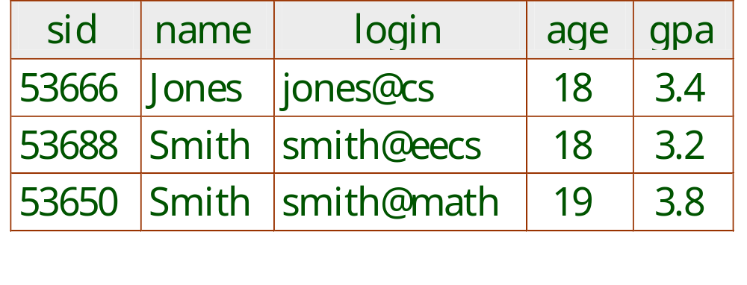
Example Instance of Students Relation
Cardinality = 3, degree = 5
Notes:
4

Slide 4
Relational Query Languages
A major strength of the relational model: supports simple, powerful querying of data.
Queries can be written intuitively, and the DBMS is responsible for efficient evaluation.
  Precise semantics for relational queries.
  Allows the optimizer to extensively re-order operations, and still ensure that the answer does not change.
Notes:
9

Slide 5
The SQL Query Language
Developed by IBM (system R) in the 1970s
Need for a standard since it is used by many vendors
Standards:
  SQL-86
  SQL-89 (minor revision)
  SQL-92 (major revision, current standard)
  SQL-99 (major extensions)

Slide 6
Creating Relations in SQL
Creates the Students relation. Observe that the type (domain) of each field is specified, and enforced by the DBMS whenever tuples are added or modified.
As another example, the Enrolled table holds information about courses that students take.
CREATE TABLE Students
(sid: CHAR(20),
name: CHAR(20),
login: CHAR(10),
age: INTEGER,
gpa: REAL)
CREATE TABLE Enrolled
(sid: CHAR(20),
cid: CHAR(20),
grade: CHAR(2))
Notes:
15

Slide 7
Adding and Deleting Tuples
Can insert a single tuple using:
INSERT INTO Students (sid, name, login, age, gpa)
VALUES (53688, ‘Smith’, ‘smith@ee’, 18, 3.2)
Can delete all tuples satisfying some condition (e.g., name = Smith):
DELETE
FROM Students S
WHERE S.name = ‘Smith’
Powerful variants of these commands are available.
Notes:
10

Slide 8
Modifying Tuples
Can modify the column values in an existing row using:
UPDATE Students S
SET S.age = S.age + 1, S.gpa = S.gpa –1
WHERE S.sid = 53688
UPDATE Students S
SET S.gpa = S.gpa – 0.1
WHERE S.gpa >= 3.3
Notes:
10

Slide 9
Integrity Constraints (ICs)
IC: condition that must be true for any instance of the database; e.g., domain constraints.
  ICs are specified when schema is defined.
  ICs are checked when relations are modified.
A legal instance of a relation is one that satisfies all specified ICs.
  DBMS should not allow illegal instances.
If the DBMS checks ICs, stored data is more faithful to real-world meaning.
Notes:
5

Slide 10
Key Constraints
A set of fields is a (candidate) key for a relation if :
  1. Two distinct tuples cannot have identical values in all the fields of a key, and
  2. No subset of the set of fields in a key is a unique identifier for a tuple
  If part 2 false, then it is a superkey.
  If there is more than one key for a relation, one of the keys is chosen (by DBA) to be the primary key.
e.g., sid is a key for Students. (What about name?) The set {sid, gpa} is a superkey.
Notes:
6

Slide 11
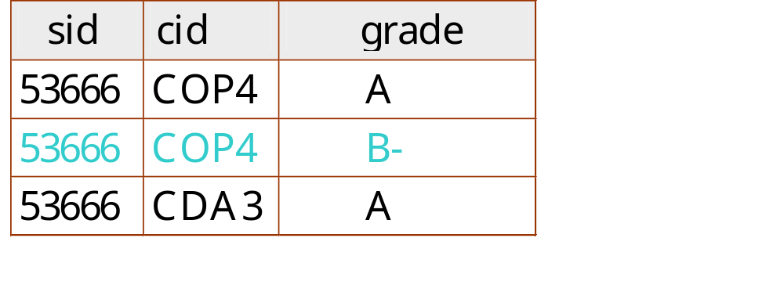
Primary and Candidate Keys in SQL
Possibly many candidate keys (specified using UNIQUE), one of which is chosen as the primary key.
“For a given student and course, there is a single grade.”
CREATE TABLE Enrolled
(sid CHAR(20)
cid CHAR(20),
grade CHAR(2),
PRIMARY KEY (sid,cid))
Notes:
6

Slide 12
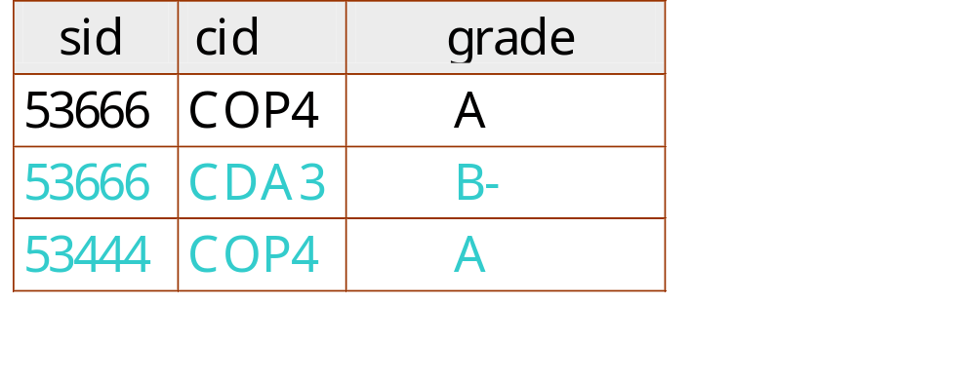
Primary and Candidate Keys in SQL
Possibly many candidate keys (specified using UNIQUE), one of which is chosen as the primary key.
“Students can take only one course, and receive a single grade for that course; further, no two students in a course receive the same grade.”
CREATE TABLE Enrolled
(sid CHAR(20)
cid CHAR(20),
grade CHAR(2),
PRIMARY KEY (sid),
UNIQUE (cid, grade) )
An IC can prevent storage of instances that arise in practice!
Notes:
6

Slide 13
Foreign Keys, Referential Integrity
Foreign key : Set of fields in one relation that is used to `refer’ to a tuple in another relation. (Must correspond to primary key of the second relation.) Like a `logical pointer’.
e.g. sid is a foreign key referring to Students:
  Enrolled(sid: string, cid: string, grade: string)
  If all foreign key constraints are enforced, referential integrity is achieved, i.e., no dangling references.
Notes:
7

Slide 14
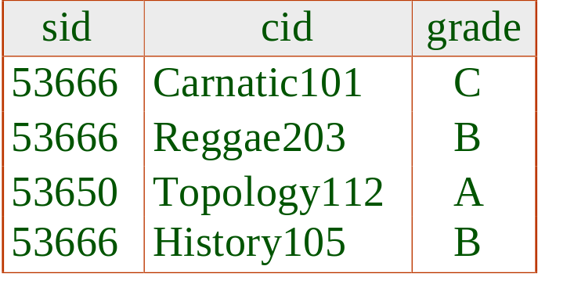
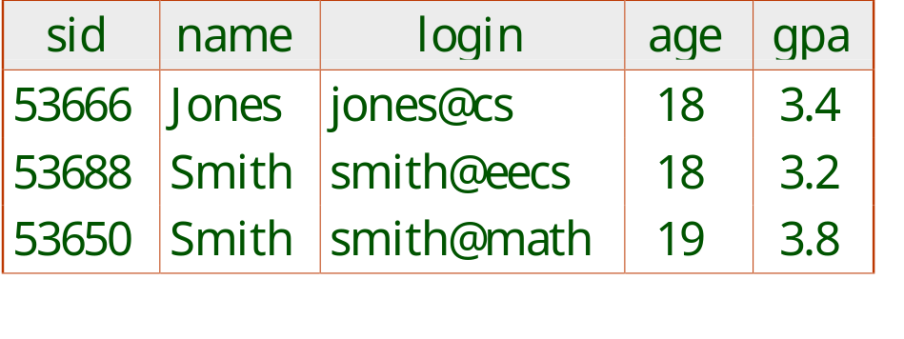
Foreign Keys in SQL
Only students listed in the Students relation should be allowed to enroll for courses.
CREATE TABLE Enrolled
(sid CHAR(20), cid CHAR(20), grade CHAR(2),
PRIMARY KEY (sid,cid),
FOREIGN KEY (sid) REFERENCES Students )
Enrolled
Students
Notes:
7

Slide 15
Enforcing Referential Integrity
Consider Students and Enrolled; sid in Enrolled is a foreign key that references Students.
What should be done if an Enrolled tuple with a non-existent student id is inserted? (Reject it!)
What should be done if a Students tuple is deleted?
  Also delete all Enrolled tuples that refer to it.
  Disallow deletion of a Students tuple that is referred to.
  Set sid in Enrolled tuples that refer to it to a default sid.
  (In SQL, also: Set sid in Enrolled tuples that refer to it to a special value null, denoting `unknown’ or `inapplicable’.)
Similar if primary key of Students tuple is updated.
Notes:
13

Slide 16
Referential Integrity in SQL/92
SQL/92 supports all 4 options on deletes and updates.
  Default is NO ACTION (delete/update is rejected)
  CASCADE (also delete all tuples that refer to deleted tuple)
  SET NULL / SET DEFAULT (sets foreign key value of referencing tuple)
CREATE TABLE Enrolled
(sid CHAR(20) DEFAULT ‘9999’,
cid CHAR(20),
grade CHAR(2),
PRIMARY KEY (sid,cid),
FOREIGN KEY (sid)
REFERENCES Students
ON DELETE CASCADE
ON UPDATE NO ACTION )
Notes:
14

